Slide 1



BMCL 2019 Winter ML
RTT(Restore The Tore) Project
이원빈
이충섭
이종수
WMLS TEAM B

Slide 2
Key Componets of the Image Completion Model
■ Completion Newtork
■ Global Context Discriminator
■ Local Context Discriminator

Slide 3
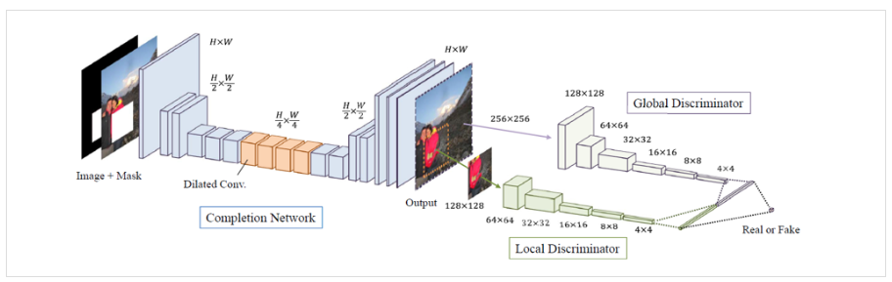
Global Discriminator
Complete Network
Local Discriminator

Slide 4
Completion Newtork
- Task of the Week
Essential notation of the layer
▶ Dilated Convolution
▶ Deconvolution
▶ Context Encoder
▶Strided Convolution

Slide 5
Weekly Done
1.Search Relating Papers
2.Study Key notations
3.Code analysis

Slide 6
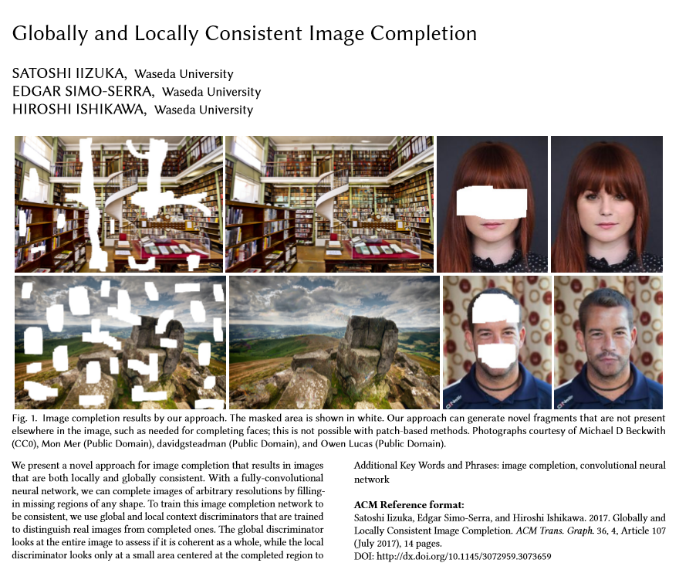
Paper Searching

Slide 7
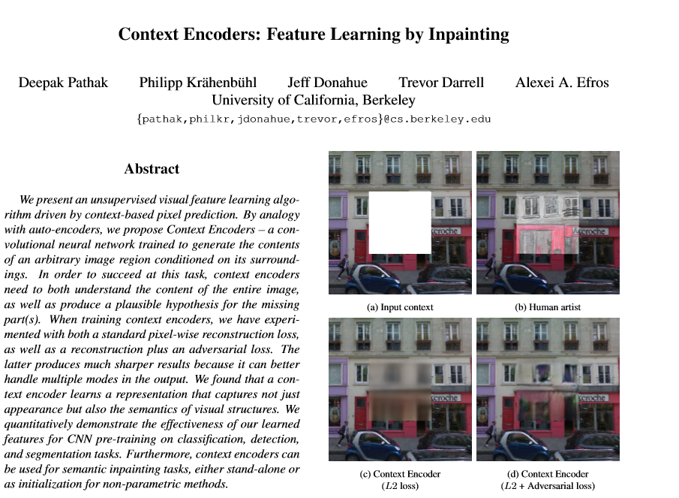
Paper Searching

Slide 8
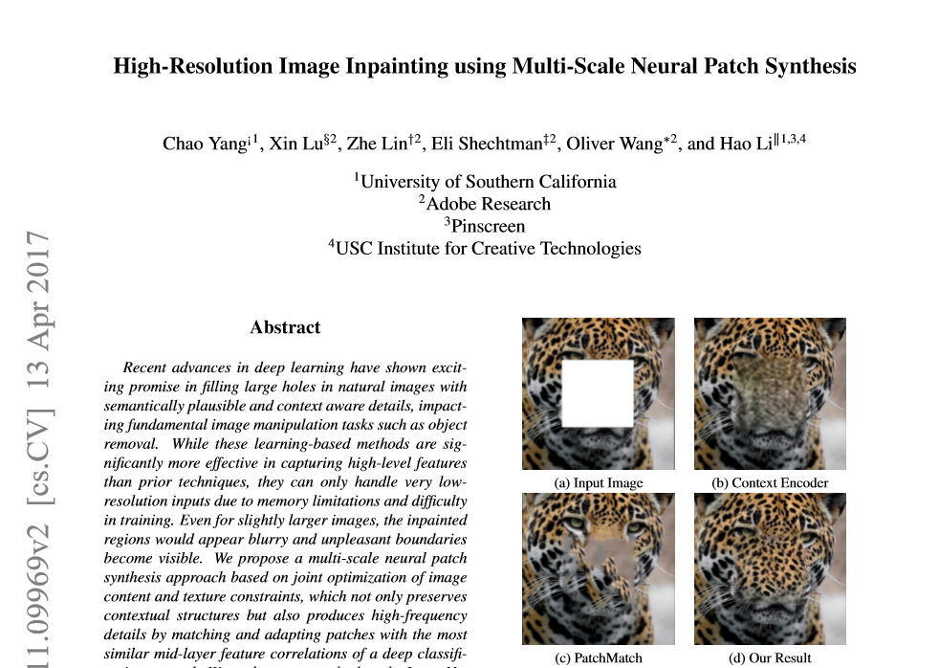
Paper Searching

Slide 9
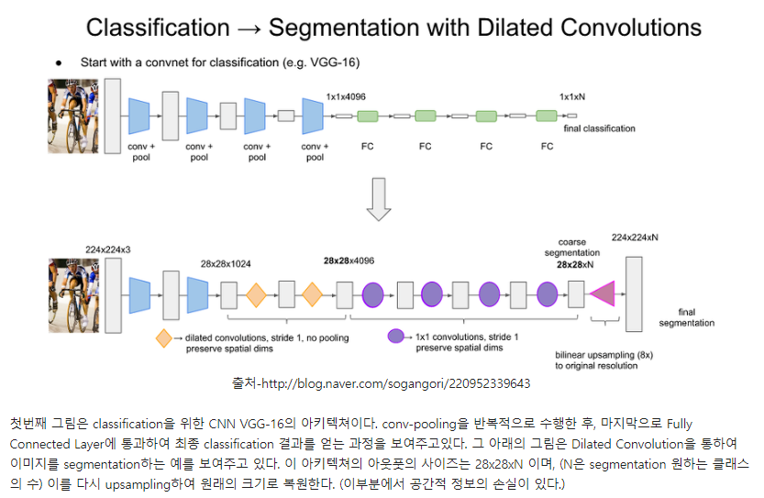
Study Key Notation

Slide 10
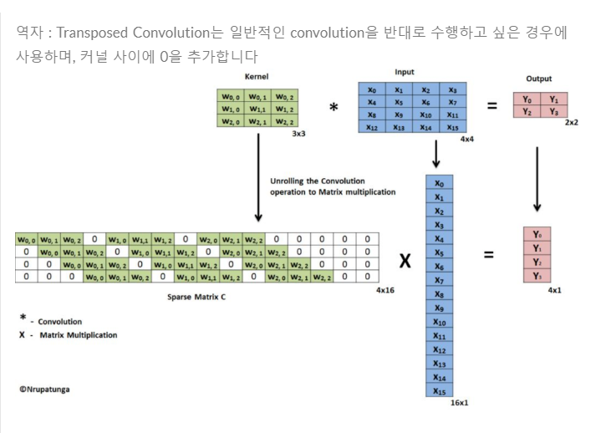
Study Key Notation

Slide 11
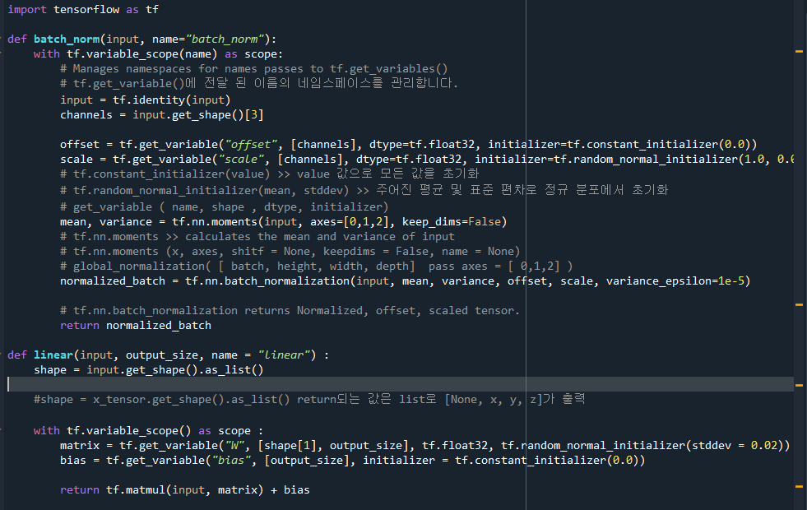
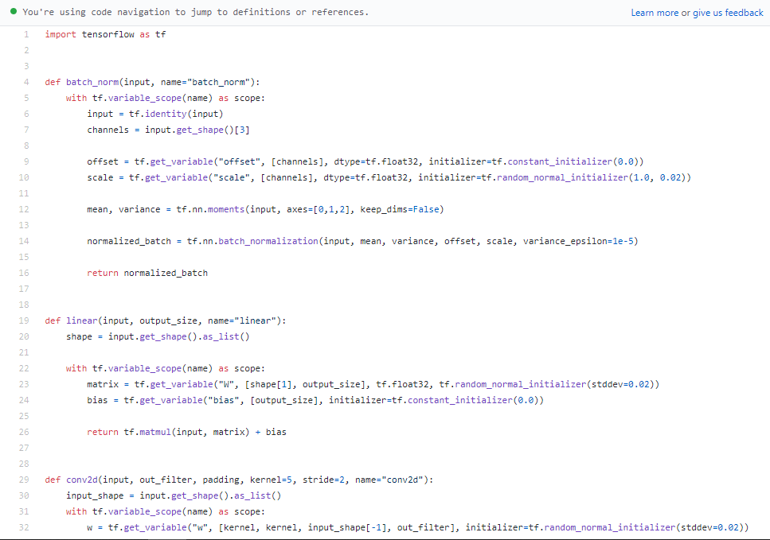
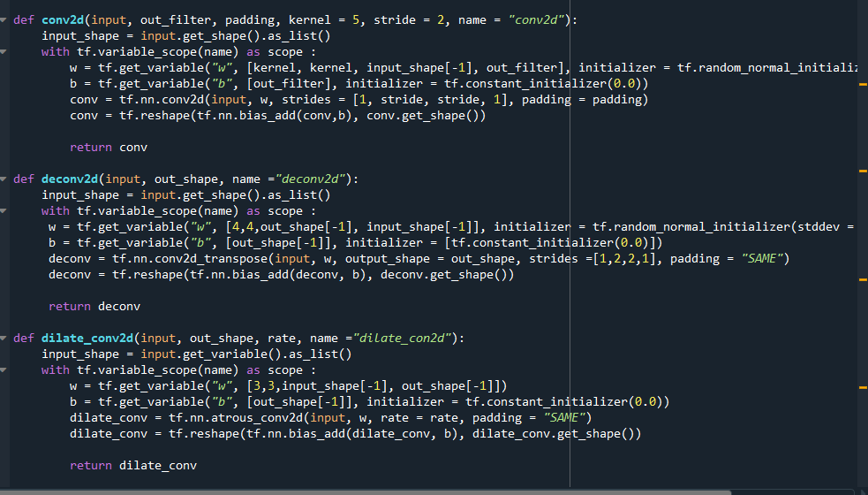
Code analysis

